Slide 1
Chapter 3
Arithmetic for Computers

Slide 2
Arithmetic for Computers
§3.1 Introduction
Operations on integers
Addition and subtraction
Multiplication and division
Dealing with overflow
Floating-point real numbers
Representation and operations

Slide 3
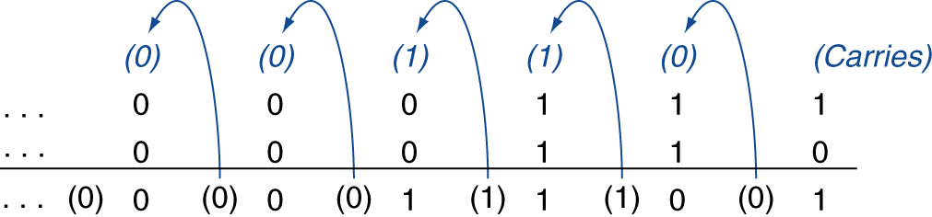
Integer Addition
Example: 7 + 6
§3.2 Addition and Subtraction
Overflow if result goes out of range
Adding +ve and –ve operands ⇒ no overflow
Adding two +ve operands (both sign bits = 0)
Overflow if result sign is 1 (negative result)
Adding two –ve operands (both sign bits = 1)
Overflow if result sign is 0 (positive result)

Slide 4
Integer Subtraction
Always do “add”
For subtraction, add negation of the 2nd operand
Example: 7 – 6 = 7 + (–6)
+7: 0000 0000 … 0000 0111 –6: 1111 1111 … 1111 1010 +1: 0000 0000 … 0000 0001
Overflow if result out of range
Subtracting two +ve or two –ve operands, no overflow
Subtracting +ve from –ve operand ( ex. –5 – (+6) )
Overflow if result sign is 0 (positive result)
Subtracting –ve from +ve operand ( ex. 5 – (–6) )
Overflow if result sign is 1 (negative result)

Slide 5
Dealing with Overflow
Some languages (e.g., C) ignore overflow
Use MIPS addu, addui, subu instructions
Other languages (e.g., Ada, Fortran) require raising an exception
Use MIPS add, addi, sub instructions
On overflow, invoke exception handler
Save PC in exception program counter (EPC) register
Jump to predefined handler address
mfc0 (move from coprocessor reg) instruction can retrieve EPC value, to return after corrective action

Slide 6
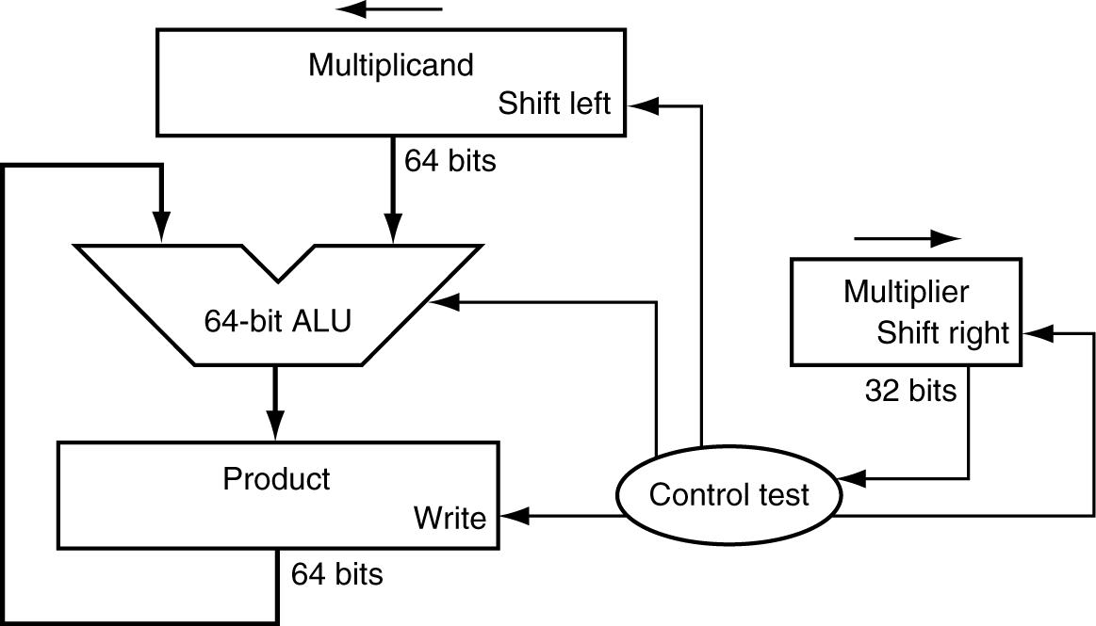
Multiplication
§3.3 Multiplication
Start with long-multiplication approach
multiplicand
1000
multiplicand
1000
× 1001
1000
0000
0000
1000
1001000
multiplier
1001
product
Length of product is the sum of operand lengths

Slide 7
Multiplication
§3.3 Multiplication
Start with long-multiplication approach
multiplicand
1000
multiplicand
1000
× 1111
1000
1000
1000
1000
1111000
multiplier
1111
product
Length of product is the sum of operand lengths

Slide 8
Multiplication
§3.3 Multiplication
Start with long-multiplication approach
multiplicand
1000
multiplicand
1000
× 1111
1000
10000
100000
1000000
1111000
multiplier
1111
product
Length of product is the sum of operand lengths

Slide 9
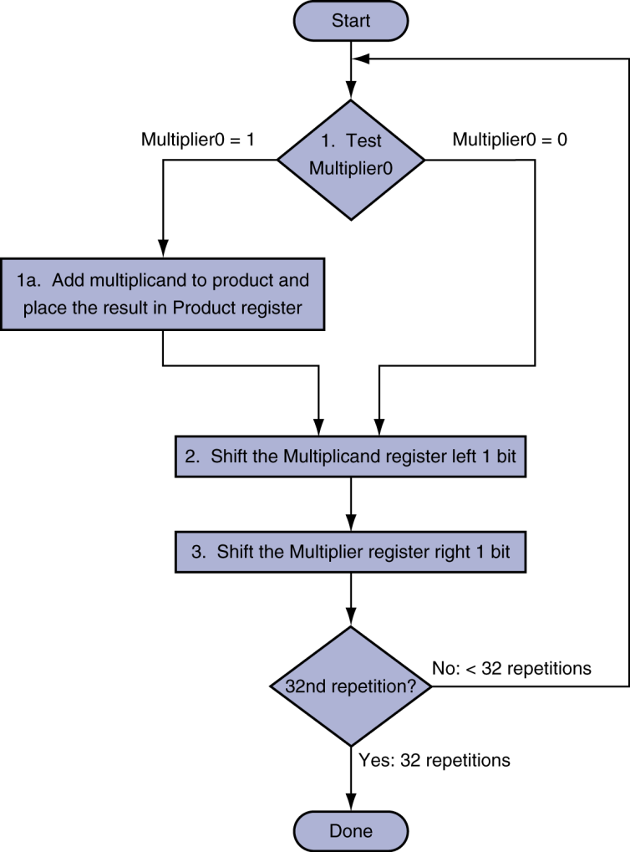
Multiplication Hardware
multiplicand
1000
1111
Initially 00000000

Slide 10
Multiplication
§3.3 Multiplication
Start with long-multiplication approach
multiplicand
1000
multiplicand
1000
× 1111
1000
10000
100000
1000000
1111000
multiplier
Fixed
1111
product
Length of product is the sum of operand lengths

Slide 11

Multiplication
§3.3 Multiplication
A
A
B
B
A
0
$$⇔$$
Fixed
A
0
+
+
0
B
Fixed
0
B

Slide 12
Multiplication
§3.3 Multiplication
Start with long-multiplication approach
multiplicand
1000
multiplicand
1000
× 1111
1000
10000
100000
1000000
1111000
Fixed
multiplier
32 bits
1111
product
Length of product is the sum of operand lengths

Slide 13
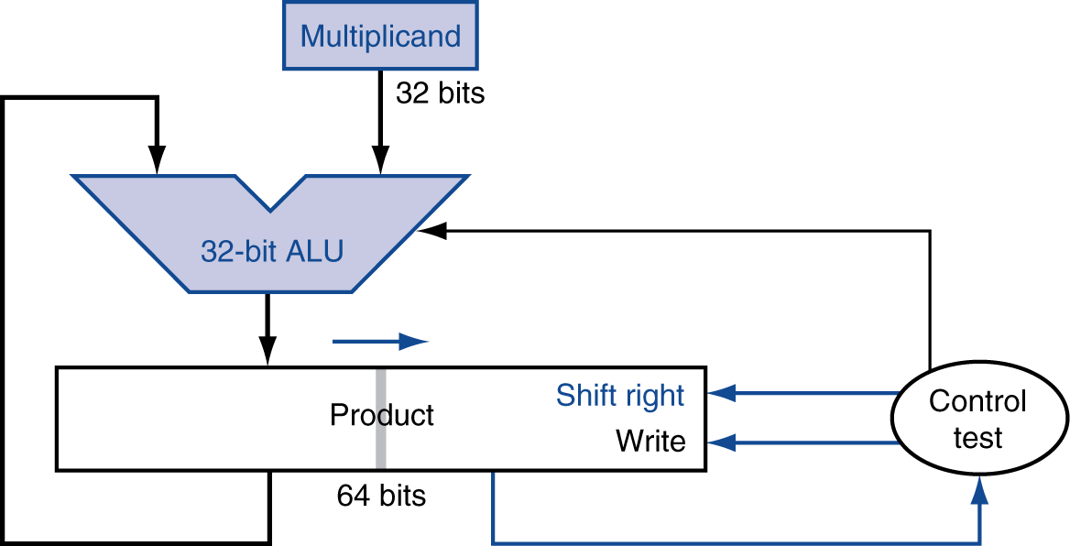
Optimized Mult Hardware
Perform steps in parallel: add/shift
1000
Multiplier
0000
1111
Multiplicand register: 32 bits
ALU: 32 bits
Multiplier register: Eliminated
One cycle per partial-product addition

Slide 14
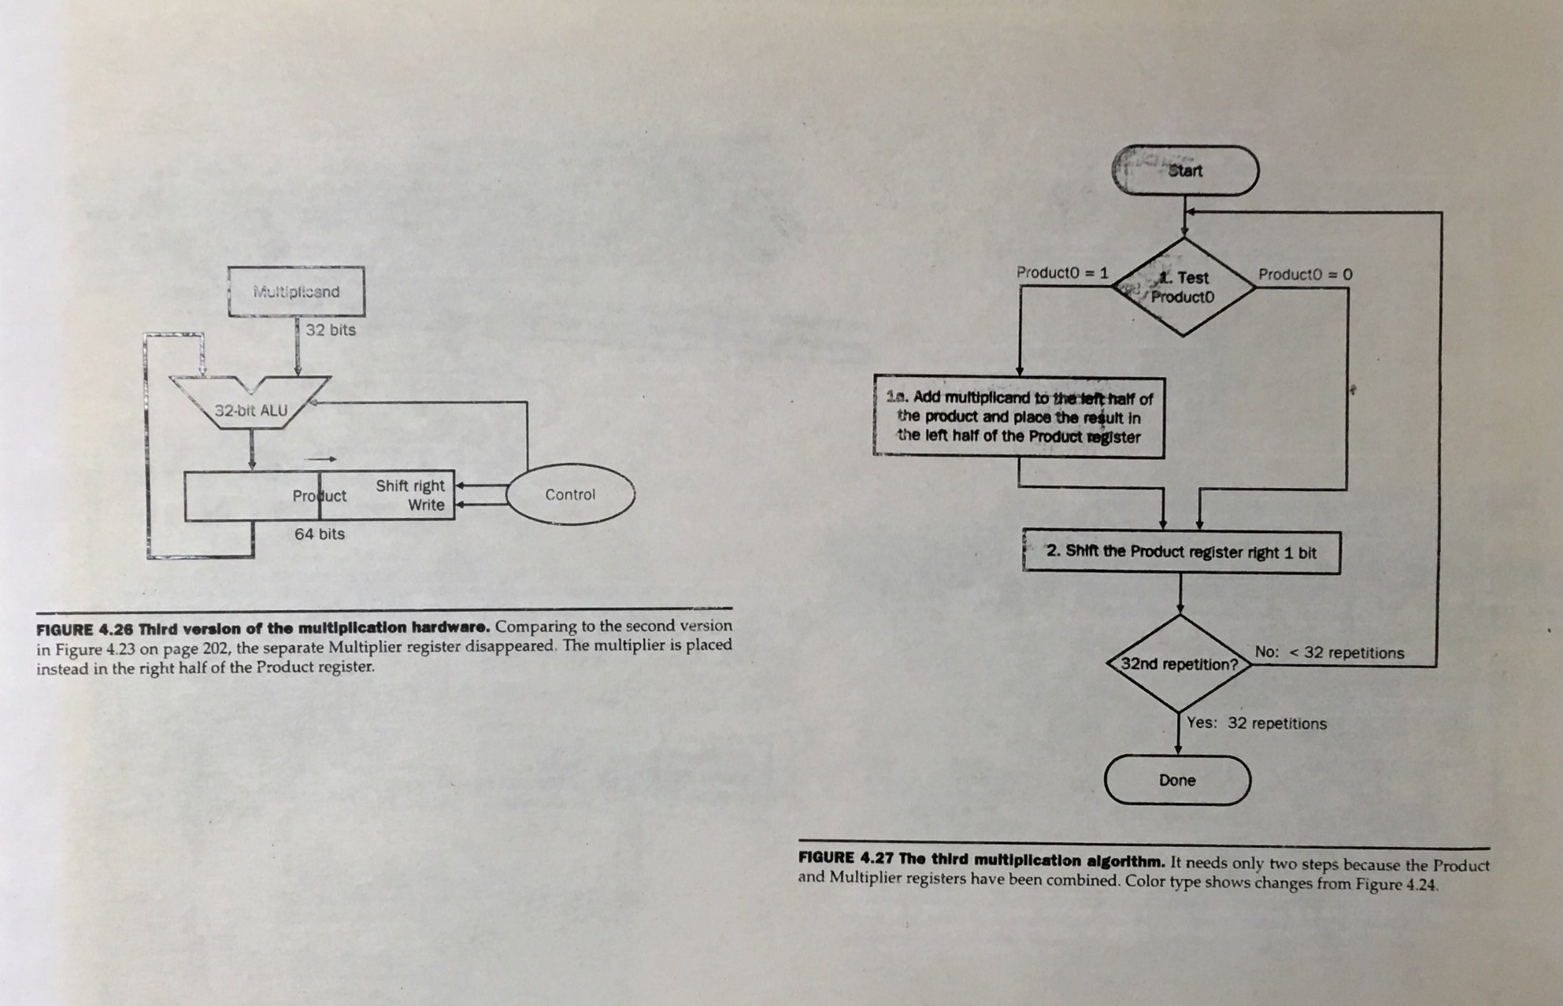

Slide 15
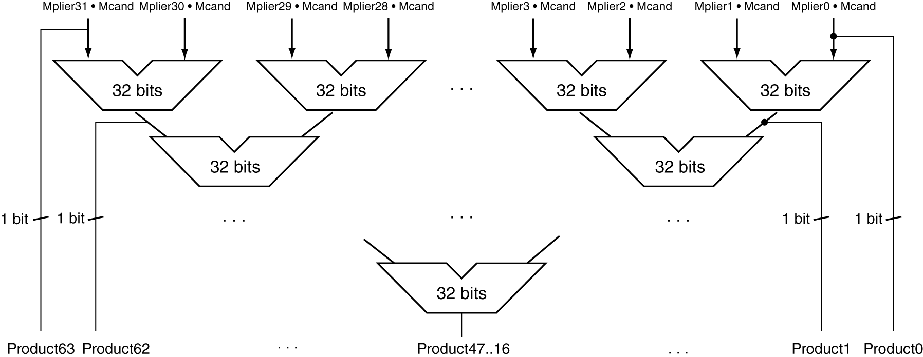
Faster (Parallel) Multiplier
To speed up mult op, use more adders
Cost/performance tradeoff
16 adders
8 adders
1 adder
Can be pipelined
Multiple multiplications performed in parallel

Slide 16
How does MIPS Multiply
Two 32-bit dedicated registers holding product
HI: most-significant 32 bits
LO: least-significant 32-bits (HI/LO not directly accessible by programmers)
Instructions
mult rs, rt / multu rs, rt
64-bit product in HI/LO;
Very expensive operation! (32 rounds of add)
mfhi rd / mflo rd
Move from HI/LO to rd
Can test HI value to see if product overflows 32 bits
mul rd, rs, rt (“small” mult)
Least-significant 32 bits of product → rd

Slide 17
Division
§3.4 Division
Check for 0 divisor (can’t do)
Long division approach
If divisor ≤ dividend bits
1 bit in quotient, subtract
Otherwise
0 bit in quotient, bring down next dividend bit
Restoring division approach
Always do the subtract; if remainder goes < 0, then add divisor back
Signed division
Divide using absolute values
Adjust sign of quotient and remainder as required
quotient
dividend
1001
1000 1001010
-1000
10
101
1010
-1000
10
divisor
remainder
2n-bit operands yield n-bit quotient and remainder

Slide 18
Division
§3.4 Division
Check for 0 divisor (can’t do)
Long division approach
If divisor ≤ dividend bits
1 bit in quotient, subtract
Otherwise
0 bit in quotient, bring down next dividend bit
Restoring division approach
Always do the subtract; if remainder goes < 0, then add divisor back
Signed division
Divide using absolute values
Adjust sign of quotient and remainder as required
quotient
dividend
1001
1000 1001010
-1000
0010
0101
1010
-1000
10
divisor
remainder
2n-bit operands yield n-bit quotient and remainder

Slide 19
Division
§3.4 Division
Check for 0 divisor (can’t do)
Long division approach
If divisor ≤ dividend bits
1 bit in quotient, subtract
Otherwise
0 bit in quotient, bring down next dividend bit
Restoring division approach
Always do the subtract; if remainder goes < 0, then add divisor back
Signed division
Divide using absolute values
Adjust sign of quotient and remainder as required
quotient
dividend
10
1000 0001010
-1000
divisor
remainder
2n-bit operands yield n-bit quotient and remainder

Slide 20
Division
§3.4 Division
Check for 0 divisor (can’t do)
Long division approach
If divisor ≤ dividend bits
1 bit in quotient, subtract
Otherwise
0 bit in quotient, bring down next dividend bit
Restoring division approach
Always do the subtract; if remainder goes < 0, then add divisor back
Signed division
Divide using absolute values
Adjust sign of quotient and remainder as required
quotient
dividend
100
1000 0001010
-1000
divisor
remainder
2n-bit operands yield n-bit quotient and remainder

Slide 21
Division
§3.4 Division
Check for 0 divisor (can’t do)
Long division approach
If divisor ≤ dividend bits
1 bit in quotient, subtract
Otherwise
0 bit in quotient, bring down next dividend bit
Restoring division approach
Always do the subtract; if remainder goes < 0, then add divisor back
Signed division
Divide using absolute values
Adjust sign of quotient and remainder as required
quotient
dividend
1001
1000 0001010
-1000
divisor
remainder
2n-bit operands yield n-bit quotient and remainder

Slide 22
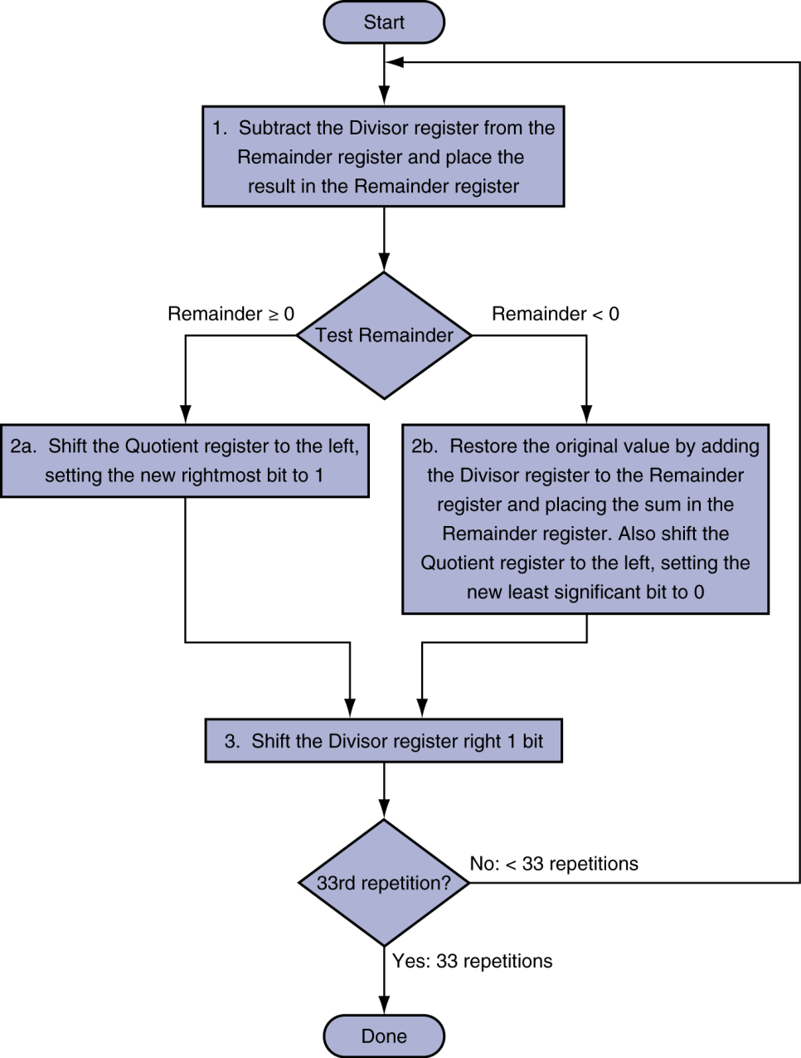
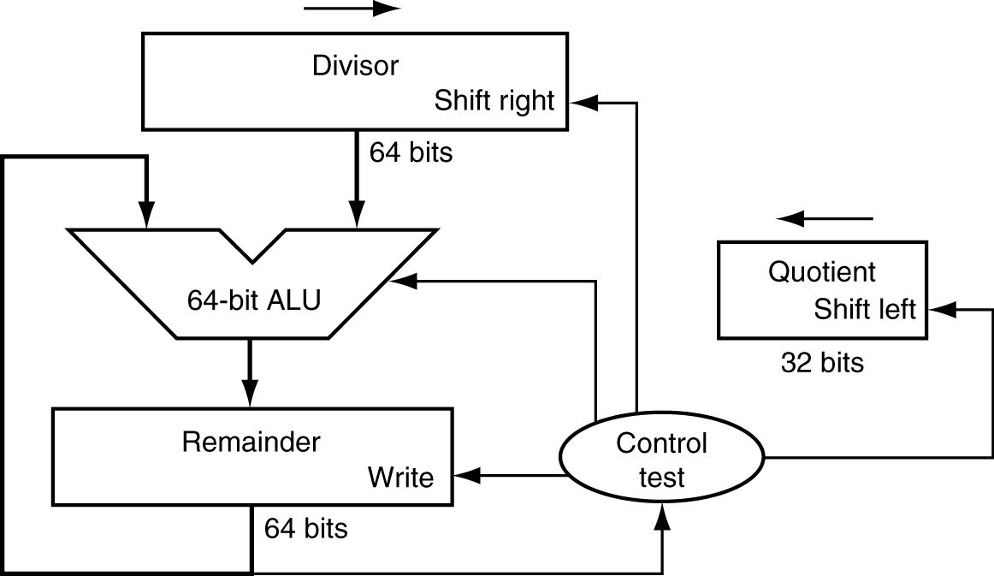
Division Hardware
Initially divisor in left half
divisor
Initially dividend

Slide 23
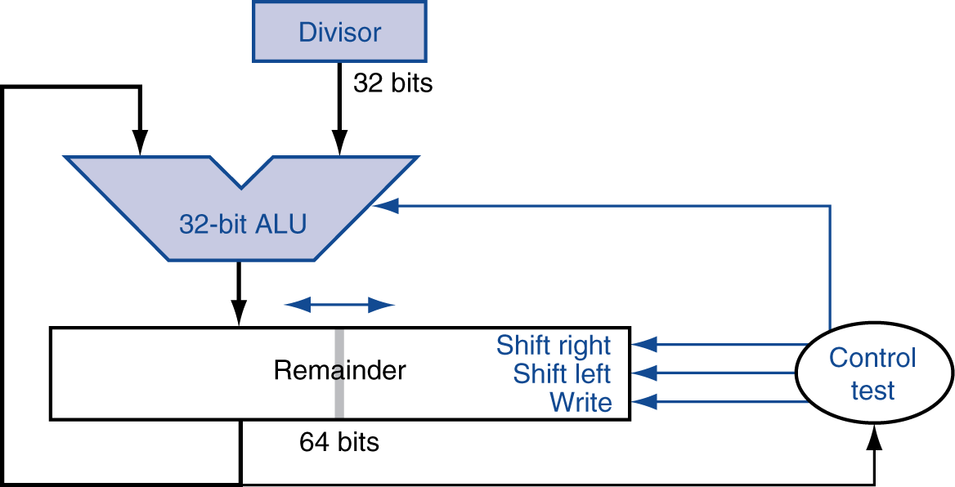
Optimized Divider
1000
Shift right: multiplication
Shift left: division
1001010
At the end: Remainder Quotient
One cycle per partial-remainder subtraction

Slide 24
Optimized Divider
Looks a lot like a multiplier!
Same hardware can be used for both

Slide 25

MIPS Division
Use HI/LO registers for result
HI: 32-bit remainder
LO: 32-bit quotient
Instructions
div rs, rt / divu rs, rt
No overflow or divide-by-0 checking
Software must perform checks if required
Use mfhi, mflo to access result

Slide 27
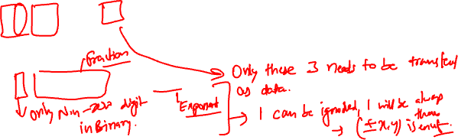
Floating Point
§3.5 Floating Point
Representation for non-integer numbers
Including very small and very large numbers
float and double in C/C++, Java
Like scientific notation
+0.002 × 10^{–4}
+987.02 × 10⁹
–2.34 × 10⁵⁶
In binary
±1.xxxxxxx₂ × 2^{yyyy}
not normalized
normalized: one non-zero digit before decimal

Slide 28
Floating Point Standard
Universal floating point standard:
Two representations
Single precision (32-bit), for float
Double precision (64-bit), for double

Slide 29
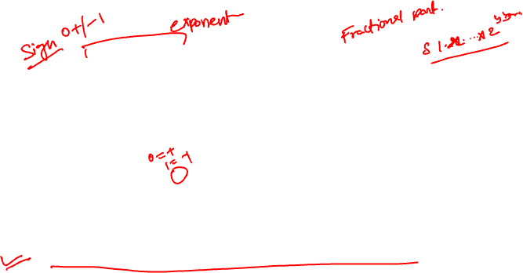
Single Precision
single: 8 bits (signed)
single: 23 bits
S
yyyyyyyy
xxxxxxxxxxxxxxxxxxxxxx
single: 8 bits (signed)
single: 23 bits
S
Exponent
Fraction
$$value=(−1)^{S}×(1.Fraction)×2^{(Exponent−Bias)}$$
S: sign bit (0 ⇒ non-negative, 1 ⇒ negative)
Normalize significand: 1.0 ≤ |significand| < 2.0
Always has a leading pre-binary-point 1 bit, so no need to represent it explicitly (hidden bit)
Significand is Fraction with the “1.” restored

Slide 30
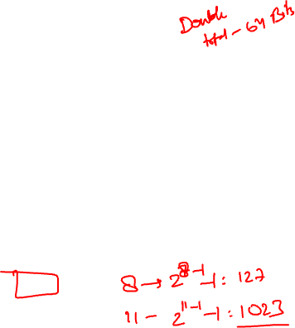
Floating-Point Numbers
Single/double: 8/11 bits (signed)
Single/double: 23/52 bits
S
yyyyyyyy
xxxxxxxxxxxxxxxxxxxxxx
Single/double: 8/11 bits (signed)
Single/double: 23/52 bits
S
Exponent
Fraction
$$value=(−1)^{S}×(1.Fraction)×2^{(Exponent−Bias)}$$
To make exponent unsigned
Single: Bias = 127
Double: Bias = 1023

Slide 31

Biased exponents
In processing floating numbers, we need to compare exponents quickly
But in 2’s complement, a negative number “looks like” bigger than positive one
In hardware, it is quicker to compare two unsigned numbers than signed ones
Hence the idea of bias: turn all exponents into positive (i.e. unsigned) for comparison purpose

Slide 32
Biased exponents
Example: 4-bit signed numbers
Let bias = 7
-7 + 7 = 0000 biased exponent
-6 + 7 = 0001
-5 + 7 = 0010
-4 + 7 = 0011
-3 + 7 = 0100
-2 + 7 = 0101
-1 + 7 = 0110
-0 + 7 = 0111
1 + 7 = 1000
2 + 7 = 1001
3 + 7 = 1010
4 + 7 = 1011
5 + 7 = 1100
6 + 7 = 1101
7 + 7 = 1110
8 + 7 = 1111
real exponent

Slide 34
Floating-Point Numbers
Single/double: 8/11 bits (signed)
Single/double: 23/52 bits
S
yyyyyyyy
xxxxxxxxxxxxxxxxxxxxxx
Single/double: 8/11 bits (signed)
Single/double: 23/52 bits
S
Exponent
Fraction
$$value=(−1)^{S}×(1.xx…xxx)×2^{(yy…yyy−Bias)}$$
$$value=(−1)^{S}×(1.Fraction)×2^{(Exponent−Bias)}$$
To make exponent unsigned
Single: Bias = 127
Double: Bias = 1023

Slide 35
Biased exponents
In exponent field: actual exponent + Bias
To make exponent unsigned
Single precision: Bias = 127
Double precision: Bias = 1023

Slide 36
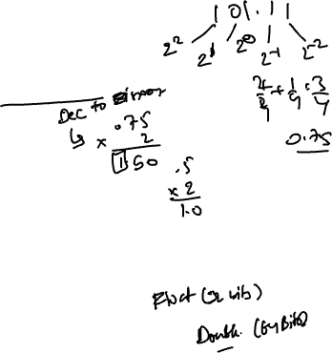
Floating-Point Example
Represent –0.75₁₀
–0.75₁₀ = –0.11₂ = –1.1₂ × 2^{–1}
S = 1
Fraction = 1000…00₂
Exponent = –1 + Bias
Single: –1 + 127 = 126 = 01111110₂
Double: –1 + 1023 = 1022 = 01111111110₂
Single: 1011111101000…00
Double: 1011111111101000…00

Slide 37
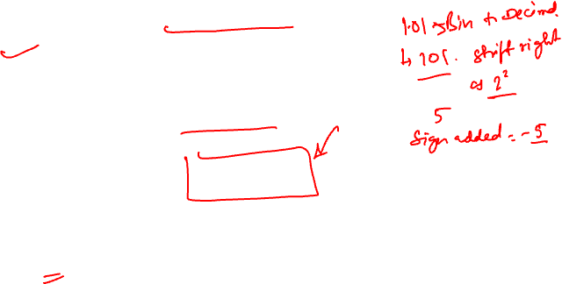
Floating-Point Example
What number is represented by the single-precision float
11000000101000…00 ?
S = 1
Fraction = 01000…00₂
Exponent = 10000001₂ = 129
– (1.01₂) × 2^{(129 – 127)}
= – 1.25 × 2²
= – 5.0

Slide 38
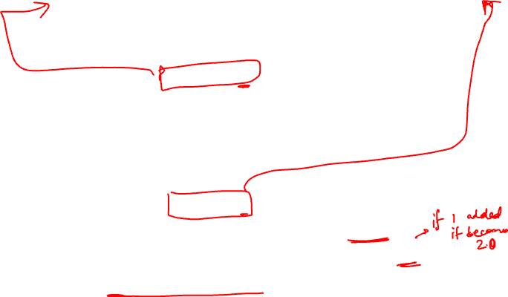
Single-Precision Range
Exponents 00000000 and 11111111 reserved for special purposes, not for “ordinary” values
Smallest value
Exponent: 00000001 ⇒ actual exponent = 1 – 127 = –126
Smallest fraction: 000…00 ⇒ significand = 1.0
±1.0 × 2^{–126} ≈ ±1.2 × 10^{–38}
Largest value
Exponent: 11111110 (= 254₁₀) ⇒ actual exponent = 254 – 127 = +127
Largest fraction: 111…11 ⇒ significand ≈ 2.0
±2.0 × 2⁺¹²⁷ ≈ ±3.4 × 10⁺³⁸

Slide 39
Double-Precision Range
0000…00 and 1111…11 not used for exponents
Reserved for special purposes
Smallest value
Exponent: 00000000001 ⇒ actual exponent = 1 – 1023 = –1022
Smallest fraction: 000…00 ⇒ significand = 1.0
±1.0 × 2^{–1022} ≈ ±2.2 × 10^{–308}
Largest value
Exponent: 11111111110 (= 2046₁₀) ⇒ actual exponent = 2046 – 1023 = +1023
Largest fraction: 111…11 ⇒ significand ≈ 2.0
±2.0 × 2⁺¹⁰²³ ≈ ±1.8 × 10⁺³⁰⁸

Slide 40
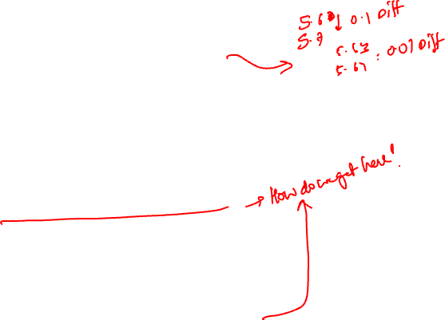
Floating-Point Precision
Relative precision
interval between numbers
smallest interval between numbers
Single: approximately 2^{–23}
2^{–23} = 10–?
Equivalent to 23 × log₁₀2 ≈ 23 × 0.3
≈ 6 decimal digits of precision
Double: approximately 2^{–52}
2^{–52} = 10–?
Equivalent to 52 × log₁₀2 ≈ 52 × 0.3
≈ 16 decimal digits of precision

Slide 41
Floating-Point Range/Precision
single: 8 bits (signed)
single: 23 bits
S
Exponent
Fraction
Range: ±1.2 × 10^{–38} – 3.4 × 10⁺³⁸
Precision: 0.000001
double: 11 bits (signed)
double: 52 bits
S
Exponent
Fraction
Range: ±2.2 × 10^{–308} – 1.8 × 10⁺³⁰⁸
Precision: 0.0000000000000001
To put in perspective, according to estimates, the whole Milky Way Galaxy contains approximately 10⁶⁷ atoms

Slide 42
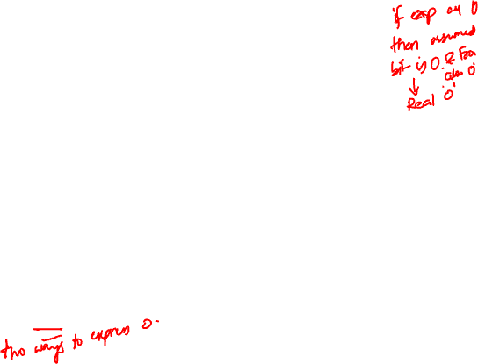
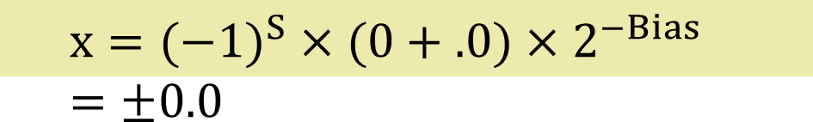
Denormal Numbers
Exponent = 000...0 ⇒ hidden bit is 0
$$x=(−1)^{S}×(0.Fraction)×2^{−Bias}$$
Smaller than normal numbers (smaller than the smallest number that can be represented in this computer)
Denormal with fraction = 000...0
$$x=(−1)^{S}×(0+.0)×2^{−Bias} =±0.0$$
Two representations of 0.0!

Slide 43
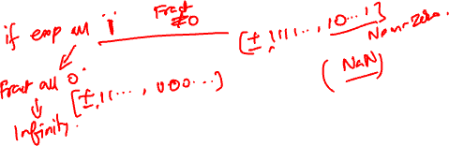
Infinities and NaN
Exponent = 111...1, Fraction = 000...0
±Infinity (0111111110000…00)
Exponent = 111...1, Fraction ≠ 000...0
Not-a-Number (NaN)
Indicates illegal or undefined result
e.g., x / 0.0
Can be used in subsequent calculations

Slide 45
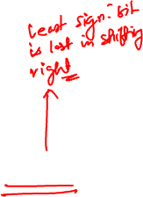
Floating-Point Addition
Consider a 4-digit decimal example
9.999 × 10¹ + 1.612 × 10^{–1}
1. Align decimal points
Right-shift number with smaller exponent (why?)
9.999 × 10¹ + 0.016 × 10¹
2. Add significands
9.999 × 10¹ + 0.016 × 10¹ = 10.015 × 10¹
3. Normalize result & check for over/underflow
1.0015 × 10²
4. Round and renormalize if necessary
1.002 × 10²
Right-shifted

Slide 46
Floating-Point Addition
Now consider a 4-digit binary example
1.000₂ × 2^{–1} + –1.110₂ × 2^{–2} (0.5 + –0.4375)
1. Align binary points
Right-shift number with smaller exponent
1.000₂ × 2^{–1} + –0.111₂ × 2^{–1}
2. Add significands
1.000₂ × 2^{–1} + –0.111₂ × 2^{–1} = 0.001₂ × 2^{–1}
3. Normalize result & check for over/underflow
1.000₂ × 2^{–4}, with no over/underflow
4. Round and renormalize if necessary
1.000₂ × 2^{–4} (no change) = 0.0625₁₀
Right-shifted

Slide 47
FP Adder Hardware
Much more complex than an integer adder
Doing it in one clock cycle would take too long
Much longer than integer operations
Slower clock would penalize all instructions
So FP adder usually takes multiple cycles

Slide 48
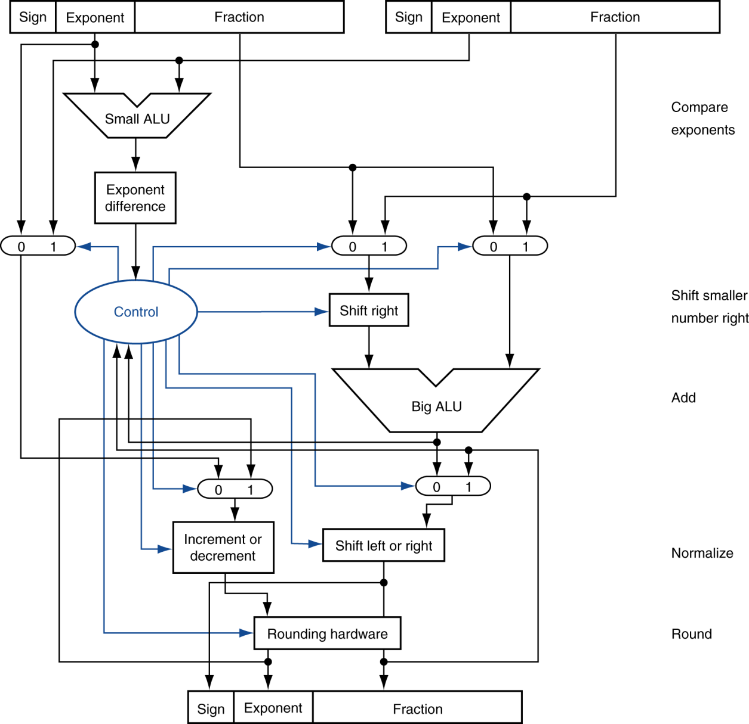
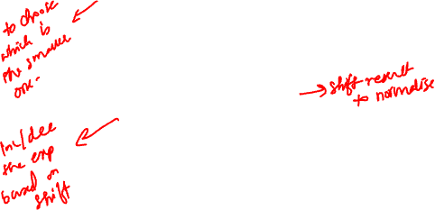
FP Adder Hardware
Step 1
Integer adder
Step 2
Step 3
Step 4

Slide 49
Floating-Point Multiplication
Consider a 4-digit decimal example
1.110 × 10¹⁰ × 9.200 × 10^{–5}
1. Add exponents
For biased exponents, subtract bias from sum
New exponent = 10 + –5 = 5
2. Multiply significands
1.110 × 9.200 = 10.212 ⇒ 10.212 × 10⁵
3. Normalize result & check for over/underflow
1.0212 × 10⁶
4. Round and renormalize if necessary
1.021 × 10⁶
5. Determine sign of result from signs of operands
+1.021 × 10⁶

Slide 50

Floating-Point Multiplication
4-digit binary example
1.000₂ × 2^{–1} × –1.110₂ × 2^{–2} (0.5 × –0.4375)
1. Add exponents
Unbiased: –1 + –2 = –3
Biased: (–1 + 127) + (–2 + 127) = –3 + 254 – 127 = –3 + 127
2. Multiply significands
1.000₂ × 1.110₂ = 1.110₂ ⇒ 1.110₂ × 2^{–3}
3. Normalize result & check for over/underflow
1.110₂ × 2^{–3} (no change) with no over/underflow
4. Round and renormalize if necessary
1.110₂ × 2^{–3} (no change)
5. Determine sign: +ve × –ve ⇒ –ve
–1.110₂ × 2^{–3} = –0.21875₁₀

Slide 51
FP Instructions in MIPS
FP (Floating-Point) hardware is coprocessor 1
Adjunct processor that extends the ISA (Industry Standard Architecture)
Separate FP registers
32 single-precision:
$f0, $f1, … $f31
Paired for double-precision (16 pairs):
[$f0/$f1], [$f2/$f3], … [$f30/$f31]
Release 2 of MIPs ISA supports 32 × 64-bit FP reg’s

Slide 52
FP Instructions in MIPS
FP instructions operate only on FP registers
Programs generally don’t do integer ops on FP data, or vice versa
More registers with minimal code-size impact
FP load and store instructions
lwc1, ldc1, swc1, sdc1 # c1 = coprocessor1
e.g., ldc1 $f8, 32($sp)

Slide 53
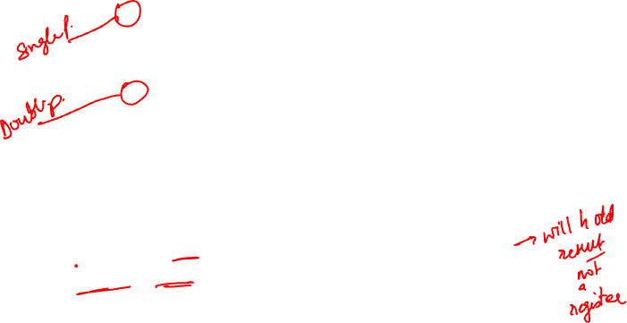
FP Instructions in MIPS
Single-precision arithmetic
add.s, sub.s, mul.s, div.s
e.g., add.s $f0, $f1, $f6
Double-precision arithmetic
add.d, sub.d, mul.d, div.d
e.g., mul.d $f4, $f4, $f6
Single- and double-precision comparison
c.xx.s, c.xx.d (xx = eq, lt, le, …)
Sets or clears FP condition-code bit
e.g., c.lt.s $f3, $f4 # a condition code is set
Branch on FP condition code true or false
bc1t, bc1f # t/f set by previous inst.
e.g., bc1t TargetLabel # goto TargetLabel if true

Slide 54
FP Example: °F to °C
C code:
float f2c (float fahr) { return ((5.0/9.0)*(fahr - 32.0)); }
fahr in $f12, result in $f0, literals (5.0, 9.0, 32.0) in global memory space (pointed by register $gp)
Compiled MIPS code:
f2c: lwc1 $f16, const5($gp) # using c1 lwc1 $f18, const9($gp) div.s $f16, $f16, $f18 # f16=5.0/9.0 lwc1 $f18, const32($gp) sub.s $f18, $f12, $f18 # fahr-32.0 mul.s $f0, $f16, $f18 jr $ra

Slide 55
FP Example: Array Multiplication
X = X + Y × Z
All 32 × 32 matrices, 64-bit double-precision elements
C code:
void mm (double x[][], double y[][], double z[][]) { int i, j, k;
for (i = 0; i! = 32; i = i + 1) for (j = 0; j! = 32; j = j + 1) for (k = 0; k! = 32; k = k + 1) x[i][j] = x[i][j] + y[i][k] * z[k][j]; }
Addresses of x, y, z in $a0, $a1, $a2, and i, j, k in $s0, $s1, $s2

Slide 56
FP Example: Array Multiplication
MIPS code:
li $t1, 32 # $t1 = 32 (row size/loop end) li $s0, 0 # i = 0; initialize 1st for loop L1: li $s1, 0 # j = 0; restart 2nd for loop L2: li $s2, 0 # k = 0; restart 3rd for loop sll $t2, $s0, 5 # $t2 = i * 32 (size of row of x) addu $t2, $t2, $s1 # $t2 = i * size(row) + j sll $t2, $t2, 3 # $t2 = byte offset of [i][j] addu $t2, $a0, $t2 # $t2 = byte address of x[i][j] l.d $f4, 0($t2) # $f4 = 8 bytes of x[i][j] L3: sll $t0, $s2, 5 # $t0 = k * 32 (size of row of z) addu $t0, $t0, $s1 # $t0 = k * size(row) + j sll $t0, $t0, 3 # $t0 = byte offset of [k][j] addu $t0, $a2, $t0 # $t0 = byte address of z[k][j] l.d $f16, 0($t0) # $f16 = 8 bytes of z[k][j] …

Slide 57
FP Example: Array Multiplication
… sll $t0, $s0, 5 # $t0 = i*32 (size of row of y) addu $t0, $t0, $s2 # $t0 = i*size(row) + k sll $t0, $t0, 3 # $t0 = byte offset of [i][k] addu $t0, $a1, $t0 # $t0 = byte address of y[i][k] l.d $f18, 0($t0) # $f18 = 8 bytes of y[i][k] mul.d $f16, $f18, $f16 # $f16 = y[i][k] * z[k][j] add.d $f4, $f4, $f16 # f4=x[i][j] + y[i][k]*z[k][j] addiu $s2, $s2, 1 # $k k + 1 bne $s2, $t1, L3 # if (k != 32) go to L3 s.d $f4, 0($t2) # x[i][j] = $f4 addiu $s1, $s1, 1 # $j = j + 1 bne $s1, $t1, L2 # if (j != 32) go to L2 addiu $s0, $s0, 1 # $i = i + 1 bne $s0, $t1, L1 # if (i != 32) go to L1

Slide 58
Interpretation of Data
The BIG Picture
Bits have no inherent meaning
Interpretation depends on the instructions applied
Computer representations of numbers
Finite range and finite precision
Need to account for this in programs

Slide 59
Note on Right Shift and Division
Left shift by i places multiplies an integer by 2^{i}
Right shift divides by 2^{i} ?
Only works for unsigned integers
For signed integers
Arithmetic right shift: replicate the sign bit
e.g., –5 / 4
11111011₂ >> 2 = 11111110₂ = –2 (not –1)
c.f.
11111011₂ >> 2 = 00111110₂ = +62
§3.8 Fallacies and Pitfalls

Slide 60
Note on Associativity
Parallel programs may interleave operations in unexpected orders
Assumptions of associativity may fail
§3.6 Parallelism and Computer Arithmetic: Associativity
Need to validate parallel programs under varying degrees of parallelism

Slide 61
Concluding Remarks
ISAs support arithmetic
Signed and unsigned integers
Floating-point approximation to real numbers
Bounded range and precision
Operations can overflow and underflow
MIPS ISA
Core instructions: 54 most frequently used
100% of SPECINT, 97% of SPECFP (almost all MIPS instructions are used in benchmarks)
Other instructions: Less frequent
Meaning: MIPS is characteristic and typical
§3.9 Concluding Remarks

